Slide 1

Assignment 3: Current Market Value Regression Model

Slide 2
Assignment
Objective
Deliverables
Conduct regression analysis on the VALUE (Current Market Value) variable from the 2013 dataset
List the variables used in the regression analysis
Discuss any data transformations
Explain the estimated regression model

Slide 3
Data Prep
Remove all rows where VALUE < $1000
Remove all rows corresponding to rental units (OWNRENT = 2)
Remove all rows corresponding to non-single-family units (STRUCTURETYPE <> 1 and TYPE <> 1)

Slide 4
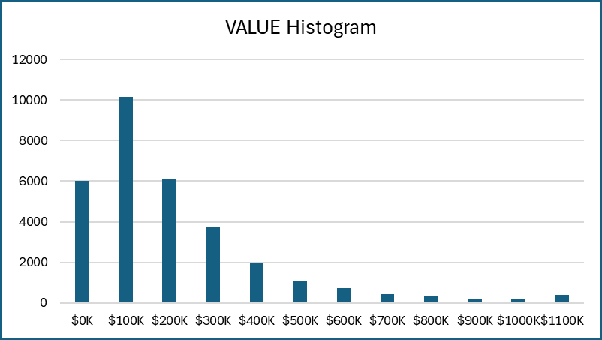
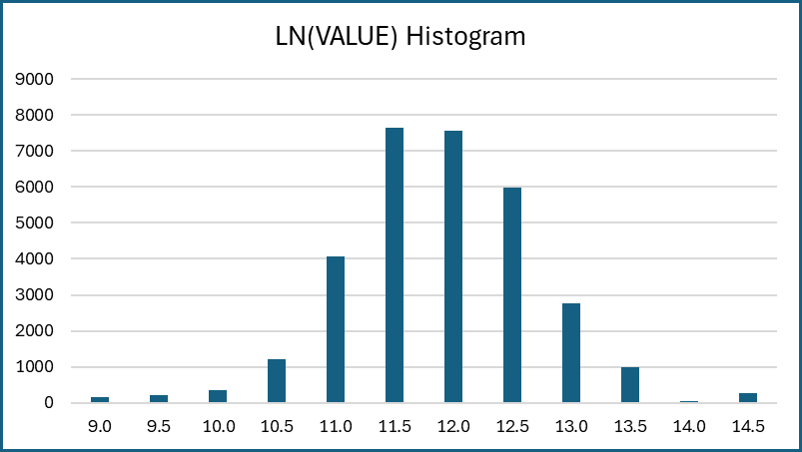
VALUE Analysis
Since the LN of VALUE is closer to a normal distribution, we will use LN(VALUE) in our regression model

Slide 5
Variables Used
METRO3: metropolitan status
REGION: census region
LMED: area median income
FMR: fair market monthly rent
BEDRMS: number of bedrooms
BUILT: year built
ZINC2: annual household income
ZSMHC: monthly housing costs, not including mortgage
UTILITY: monthly utility costs
COSTMED: monthly mortgage payment, assuming median interest

Slide 6
Data Transformations
The METRO3 variable was transformed into CCITY, using the following rule:
If METRO3 = 1 then CCITY = 1 else CCITY = 0
The REGION variable was transformed into REGNE, REGMW, and REGS, using the following rules:
If REGION = 1 then REGNE = 1 else REGNE = 0
If REGION = 2 then REGMW = 1 else REGMW = 0
If REGION = 2 then REGS = 1 else REGS = 0
LN Transformations
The following variables were transformed using the LN function to improve the fit of the regression model:
LMED
FMR
ZINC2
ZSMHC
UTILITY
COSTMED

Slide 7
Descriptive Statistics
 | VALUE | LMED | FMR | BEDRMS | BUILT | ZINC2 | ZSMHC | UTILITY | COSTMED
Mean | 258,582 | 68,208 | 1,281 | 3 | 1968 | 88,996 | 1,360 | 251 | 1,850
Standard Error | 1,583 | 71 | 2 | 0 | 0 | 484 | 6 | 1 | 10
Median | 190,000 | 64,810 | 1,204 | 3 | 1970 | 67,535 | 1,098 | 227 | 1,408
Mode | 150,000 | 79,200 | 1,394 | 3 | 1950 | 99,974 | 532 | 192 | 795
Standard Dev | 279,970 | 12,511 | 397 | 1 | 27 | 85,621 | 1,078 | 120 | 1,712
Sample Var | 78,383,215,171 | 156,515,149 | 157,755 | 1 | 710 | 7,330,876,989 | 1,162,110 | 14,488 | 2,932,572
Kurtosis | 33.5790 | 1 | 1 | 1 | (1) | 12 | 8 | 4 | 31
Skewness | 4.8474 | 1 | 1 | 0 | (0) | 3 | 2 | 2 | 5
Range | 2,510,000 | 76,800 | 3,030 | 7 | 94 | 1,061,920 | 10,658 | 1,243 | 17,049
Minimum | 10,000 | 38,500 | 481 | 0 | 1919 | 1 | 9 | 6 | 106
Maximum | 2,520,000 | 115,300 | 3,511 | 7 | 2013 | 1,061,921 | 10,667 | 1,249 | 17,155
Sum | 8,092,310,000 | 2,134,583,829 | 40,075,246 | 101,988 | 61,577,607 | 2,785,135,933 | 42,551,732 | 7,870,340 | 57,891,349
Count | 31,295 | 31,295 | 31,295 | 31,295 | 31,295 | 31,295 | 31,295 | 31,295 | 31,295

Slide 8
Regression Model
The following regression model was used in the analysis of VALUE:
LN(VALUE) = β₀ + β₁(CCITY) + β₂(REGNE) + β₃(REGMW) + β₄(REGS) + β₅(LN(LMED)) + β₆(LN(FMR)) + β₇(BEDRMS) + β₈(BUILT) + β₉(LN(ZINC2)) + β₁₀(LN(ZSMHC)) + β₁₁(LN(UTILITY)) + β₁₂(LN(COSTMED))
Running this model using 2013 data resulted in the following estimate:
LN(VALUE) = 3.4692 - 0.0156 (CCITY) + 0.0117 (REGNE) - 0.0159 (REGMW) - 0.0176 (REGS) + 0.0387 (LN(LMED)) - 0.0499 (LN(FMR)) + 0.0138 (BEDRMS) + 0.0003 (BUILT) + 0.0087 (LN(ZINC2)) - 0.0248 (LN(ZSMHC)) - 0.2252 (LN(UTILITY)) +
1.2731 (LN(COSTMED))

Slide 9
Pair-Wise Correlation
 | CCITY | REGNE | REGMW | REGS | LMED | FMR | BEDRMS | BUILT | LN(ZINC2) | LN(ZSMHC) | LN(UTILITY) | LN(COSTMED)
CCITY | 1.0000
REGNE | -0.0568 | 1.0000
REGMW | -0.0123 | -0.3664 | 1.0000
REGS | -0.0029 | -0.3709 | -0.4255 | 1.0000
LMED | 0.0077 | 0.5392 | -0.1120 | -0.4131 | 1.0000
FMR | 0.0613 | 0.3425 | -0.3799 | -0.1965 | 0.6631 | 1.0000
BEDRMS | -0.0336 | 0.0177 | -0.0295 | -0.0166 | 0.1075 | 0.5236 | 1.0000
BUILT | -0.1609 | -0.2019 | -0.0889 | 0.2065 | -0.1476 | 0.0194 | 0.1420 | 1.0000
LN(ZINC2) | -0.0497 | 0.0652 | -0.0237 | -0.0772 | 0.1617 | 0.2427 | 0.2574 | 0.1585 | 1.0000
LN(ZSMHC) | -0.0187 | 0.1945 | -0.0901 | -0.1626 | 0.3577 | 0.4647 | 0.3419 | 0.1806 | 0.4601 | 1.0000
LN(UTILITY) | 0.0257 | 0.2072 | -0.1282 | -0.0475 | 0.1990 | 0.3279 | 0.3370 | -0.0043 | 0.2462 | 0.4446 | 1.0000
LN(COSTMED) | -0.0524 | 0.2183 | -0.2371 | -0.1362 | 0.3918 | 0.5702 | 0.3778 | 0.1758 | 0.4010 | 0.6384 | 0.4126 | 1.0000
We do not have to consider correlation, as we have no values with a correlation > 90%

Slide 10
Regression Statistics
Multiple R | 0.98553898
R Square | 0.971287081
Adjusted R Square | 0.971276066
Standard Error | 0.137384864
Observations | 31295
 | df | SS | MS | F | Significance F
Regression | 12 | 19972.96546 | 1664.413788 | 88182.72714 | 0
Residual | 31282 | 590.4352679 | 0.018874601
Total | 31294 | 20563.40073
The R square value for this regression model is ~ 0.97, which is extremely high. This indicates that our regression model is a good fit to our sample data.

Slide 11
Regression Statistics
 | Coefficients | Standard Error | t Stat | P-value | Lower 95% | Upper 95% | Lower 95.0% | Upper 95.0%
Intercept | 3.46916519 | 0.095467791 | 36.33859287 | 3.131E-283 | 3.282044518 | 3.656285862 | 3.282044518 | 3.656285862
CCITY | -0.015612459 | 0.001943217 | -8.03433433 | 9.73694E-16 | -0.019421242 | -0.011803675 | -0.019421242 | -0.011803675
REGNE | 0.011720663 | 0.002922038 | 4.011125372 | 6.05704E-05 | 0.005993351 | 0.017447974 | 0.005993351 | 0.017447974
REGMW | -0.015937329 | 0.003091245 | -5.155635182 | 2.5431E-07 | -0.021996292 | -0.009878367 | -0.021996292 | -0.009878367
REGS | -0.017563063 | 0.0026834 | -6.545079037 | 6.03825E-11 | -0.022822634 | -0.012303493 | -0.022822634 | -0.012303493
LMED | 0.038721199 | 0.007979942 | 4.852315707 | 1.22615E-06 | 0.023080195 | 0.054362204 | 0.023080195 | 0.054362204
FMR | -0.049895963 | 0.005804867 | -8.59554005 | 8.66651E-18 | -0.061273733 | -0.038518194 | -0.061273733 | -0.038518194
BEDRMS | 0.013802911 | 0.001323314 | 10.43056157 | 1.97962E-25 | 0.011209163 | 0.01639666 | 0.011209163 | 0.01639666
BUILT | 0.000292257 | 3.22967E-05 | 9.049145569 | 1.52207E-19 | 0.000228955 | 0.00035556 | 0.000228955 | 0.00035556
LN(ZINC2) | 0.008673783 | 0.000854041 | 10.15617168 | 3.39149E-24 | 0.00699983 | 0.010347737 | 0.00699983 | 0.010347737
LN(ZSMHC) | -0.024764679 | 0.001466448 | -16.88753222 | 1.06529E-63 | -0.027638975 | -0.021890384 | -0.027638975 | -0.021890384
LN(UTILITY) | -0.22522188 | 0.001991587 | -113.0866559 | 0 | -0.229125469 | -0.22131829 | -0.229125469 | -0.22131829
LN(COSTMED) | 1.273146673 | 0.001741784 | 730.9442484 | 0 | 1.269732707 | 1.276560638 | 1.269732707 | 1.276560638
No variables have a p-value > 0.05, meaning they are all statistically significant in our model

Slide 12
Interpretation of Model
β₀: does not have a meaningful interpretation because it would not be practical for a home to have zero monthly expenses and zero fair market rent
β₁: houses with a central city location tend to have a value that is 1.56% less than houses located outside the central city, with all other variables remaining the same
β₂: houses located in the Northeast census region tend to have a value that is 1.17% more than houses located in the West census region, with all other variables remaining the same
β₃: houses located in the Midwest census region tend to have a value that is 1.59% less than houses located in the West census region, with all other variables remaining the same
β₄: houses located in the South census region tend to have a value that is 1.76% less than houses located in the West census region, with all other variables remaining the same
β₅: for every 1% increase in area median income, house values tend to increase by 0.04%, with all other variables remaining the same

Slide 13
Interpretation of Model
β₆: for every 1% increase in fair market rent, house values tend to decrease by 0.05%, with all other variables remaining the same
β₇: for every additional bedroom, house values tend to increase by 1.38%, with all other variables remaining the same
β₈: for every 1 year added to the year built, house values tend to increase by 0.03%, with all other variables remaining the same
β₉: for every 1% increase in annual household income, house values tend to increase by 0.01%, with all other variables remaining the same
β₁₀: for every 1% increase in monthly housing costs, house values tend to decrease by 0.02%, with all other variables remaining the same

Slide 14
Interpretation of Model
β₁₁: for every 1% increase in utility costs, house values tend to decrease by 0.23%, with all other variables remaining the same
β₁₂: for every 1% increase in monthly mortgage payments (assuming median interest), house values tend to increase by 1.27%, all other variables remaining the same

Slide 15
Summary
The following regression model provides a statistically sound analysis of the current market value for single-family houses based on our 2013 dataset:
LN(VALUE) = β₀ + β₁(CCITY) + β₂(REGNE) + β₃(REGMW) + β₄(REGS) + β₅(LN(LMED)) + β₆(LN(FMR)) + β₇(BEDRMS) + β₈(BUILT) + β₉(LN(ZINC2)) + β₁₀(LN(ZSMHC)) + β₁₁(LN(UTILITY)) + β₁₂(LN(COSTMED))

